Slide 1

MIRPUR UNIVERSITY OF SCIENCE AND TECHNOLOGY (MUST), MIRPUR DEPARTMENT OF COMPUTER SCIENCE & INFORMATION TECHNOLOGY

Slide 2
Professional Practices Lecture [9]: Security and Privacy: Computers and The Internet
Dr. Anum Tariq
(Lecturer)
Date: April 23, 2020

Slide 3

Objectives
Explain the different types of computer crime and the difficulties of discovery and action.
Describe the aspects of securing corporate data, including software and data security, disaster recovery plans, and security legislation.
Describe in general terms how viruses work, the damage they can cause, and procedures used to prevent this damage.
Explain the threats to personal privacy posed by computers and the Internet. Describe actions you can take to maximize your privacy.

Slide 4
Today’s Agenda
Computer Crimes:
Security and Privacy
Hackers for Hire
Which Systems Have Been attacked?
How Can Systems be Easily Compromised?
Frequently Reported Crimes
Discovery and Prosecution

Slide 5
Objectives
Understand how computer ethics affects IS (Information Security).
Understand information privacy, accuracy, property, and accessibility
Understand types of computer crime
Understand the terms virus, worm, Trojan horse, and logic or time bomb
Understand computer security

Slide 6
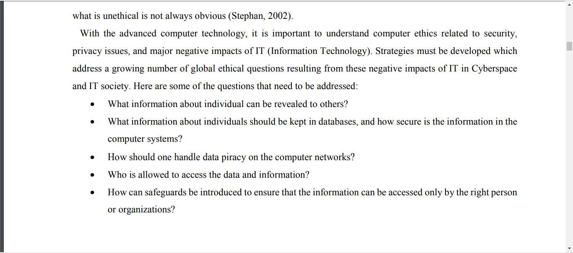
Professional Practices
6

Slide 7
Computer Crimes
Stealing and using or selling of data:
Company data
Personal information in company files
Professional Practices
7

Slide 8
Computer Crime
Employees and individuals need to recognize the possible danger from computer systems and protect their assets.

Slide 9
Computer Crime Security and Privacy
Data communications capabilities provides new challenges
Keep data secure
Destruction
Accidental damage
Theft
spying
Keep data private
Salaries
Medical information
Social security numbers
Bank balances

Slide 10
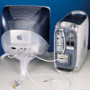
Computer Crime
Ways to secure data:
Locked servers
Removable hard drives that are locked when not in use
Hard disk drives requiring special tools for detachment (lack of involvement)
Physical cages around computers that prohibit access
Pass wording files
Professional Practices
8

Slide 11
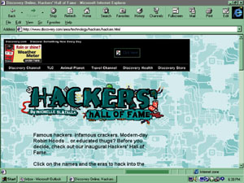
Computer Crime
Supplies for the Hacker
PC
Communications network
Why hack?
Harass
Show-off
Gain access to computer services without paying
Obtain information to sell
Hackers are individuals who attempt to gain access to computer systems illegally

Slide 12
Computer Crime Hackers for Hire
Computer professionals hired to illegally gain entry into a system
Reveal weak points
Protect the points
May not alert its own employees of the testing
Tiger teams:a team of specialists in a particular field brought together to work on specific tasks.
Red teams, sneakers: A red team is an independent group that challenges an organization to improve its effectiveness by assuming an adversarial role or point of view. It is particularly effective in organizations with strong cultures and fixed ways of approaching problems.

Slide 13
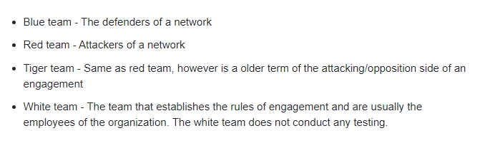
Computer Crime Hackers for Hire

Slide 14
Hackers training program in Lahore, Pakistan
http://www.stscomps.com/ceh.htm

Slide 15
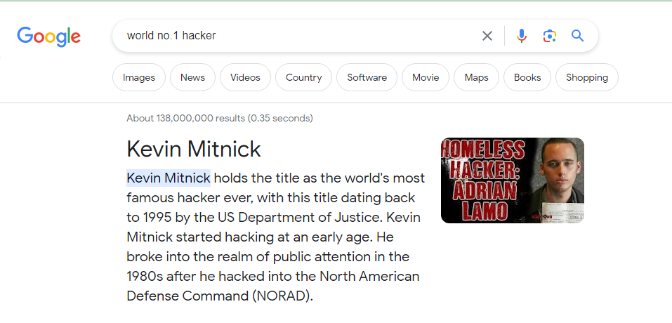
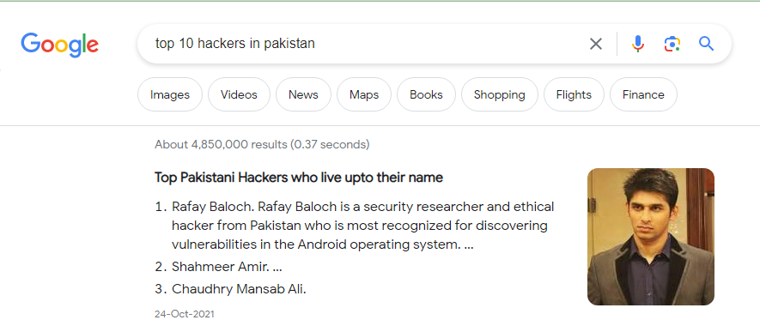

Slide 16
Computer Crime Hackers for Hire
Intrusion tester:To stop a hacker before he even thinks about getting into the target system, an IT system administrator has to try to get into the system himself using the same techniques that a hacker would use. It may seem a bit strange at first to consider hiring someone to hack into your system, but it is the only way to learn whether you are truly secure.
White hat hackers:The term "white hat" in Internet slang refers to an ethical computer hacker, or a computer security expert, who specializes in penetration testing and in other testing methodologies that ensures the security of an organization's information systems.
Ethical hacking is a term meant to imply a broader category than just penetration testing. Contrasted with black hat, a malicious hacker, the name comes from Western films, where heroic and antagonistic cowboys might traditionally wear a white and a black hat respectively. While a white hat hacker hacks under good intentions with permission, and a black hat hacker has malicious intent,
there is a third kind known as a grey hat hacker who hacks with good intentions without permission.

Slide 17
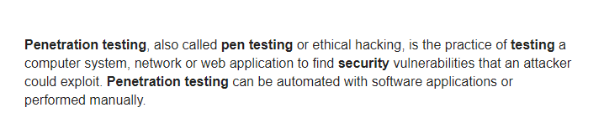

Slide 18
Computer Crime Which Systems Have Been attacked?
Corporate networks
Over half largest corporations were invaded
Competitors?
Government networks
Dept. of Defense attacked more than 200,000 times per year
Computer attack abilities of other nations?
Web sites

Slide 19
Computer Crime Which Systems Have Been attacked?
American authorities charge UK man with hacking Army, Missile Defense Agency and NASA websites
Anonymous hack US Department of Defense – Analysis of the Attack
How Chinese hackers steal U.S. secrets
Pentagon Source Says China Hacked Defense Department Computers

Slide 20
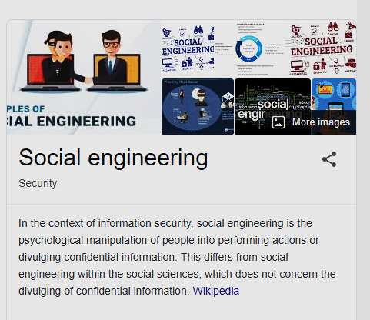
Computer Crime How Can Systems be Easily Compromised?
Social engineering
Encourage others to give away their passwords over the phone

Slide 21
Computer Crime How Can Systems be Easily Compromised?
Electronic pickpockets
Use computers to transfer or change assets to their advantage
ATM fraudster faces jail after skimming 9,000 PINs

Slide 22
Computer Crime Frequently Reported Crimes
Credit-card fraud
Numbers captured and used fraudulently
Data communications fraud
Piggyback on someone else’s network
Office network for personal purposes
Computer-directed diversion of funds
Unauthorized access to computer files
Accessing confidential employee records
Theft of trade secrets and product pricing
Unlawful copying of copyrighted software
Casual sharing of copyrighted software
Assembly-line copying

Slide 23
Computer Crimes
Bomb
Program to trigger damage
Scheduled to run at a later date
May be found in software for general public, especially shareware
Data diddling (cheating)
Changing data before or as it enters the system
Denial of service attack (DOS)
Hackers bombard a site with more request for service than it can possible handle
Prevents legal users from accessing the site
Appearance of requests coming from many different sites simultaneously

Slide 24
Computer Crimes
Piggybacking
Original user does not sign off properly
Intruder gains accesses to files via the original user id
Salami technique
Fraud/ stealing
In a banking system, the amount of interest to be credited to an account is rounded off. Instead of rounding off the number, that fraction of it is credited to a special account owned by the perpetrator.
Scavenging
Search garbage and recycling bins for personal information

Slide 25
Computer Crimes
Trapdoor
illegal program left within a completed legal program
Permits unauthorized and unknown entry to the program
Trojan horse
Illegal instructions placed inside a legal program
Program does something useful and destructive at the same time
Zapping
Software to bypass security systems

Slide 26
Trapdoor
End User Piracy at Work and at Home
"John" was the head of a new division of End Corp., a small company with about 45 PCs. John was hired to reduce expenses for the company and so he decided to cut corners on his software licenses. John would only authorize the purchase of one copy of each software program. His rationale was, "we bought it, and we can do what we want to do with it." John's plan seemed to work until the day that one of his employees called the software publisher for technical support for the pirated software. The publisher knew they were not licensed for multiple users so they called SIIA. End Corp., facing the possibility of a copyright infringement lawsuit, agreed to pay a fine of $270,000 for the illegal software. In addition, End Corp. was required to destroy all illegal software and re-purchase what it needed to be legal. The total cost to End Corp. for failing to comply with the copyright law was in excess of $500,000.
The unauthorized copying of personal computer software for use in the office or at home or sharing of software among friends is the most pervasive form of piracy encountered abroad and in the United States

Slide 27
Computer Crimes
Discovery
Difficult
Accidental
85% of computer crimes are never reported
Prosecution
Legal representatives lack technical knowledge to understand the crime

Slide 28
Computer Crime Discovery and Prosecution
Computer Fraud and Abuse Act – 1986
Computer criminals subject to
Fines
Jail time
Confiscation of hardware
Supplemented by state statutes
Professional Practices
21

Slide 29
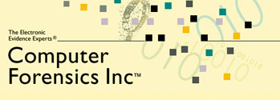
Computer Crime Discovery and Prosecution
Computer Forensics
Uncovering computer-stored information suitable for legal use
Professional Practices
22

Slide 30
References
Zlatanov, N., Computer security and mobile security challenges.
spoofing. Oxford Reference. Oxford University Press. 21 January 2016.
Klein, A. and Boodaei, M., Trusteer Ltd, 2015. Detection of phishing attempts. U.S. Patent 9,111,090.
Havens, J.C., 2015. Hacking happiness: Why your personal data counts and how tracking it can change the world. TarcherPerigee.

Slide 31
THANKS

